Slide 1
Project Update 3/20
Josh Howard

Slide 2
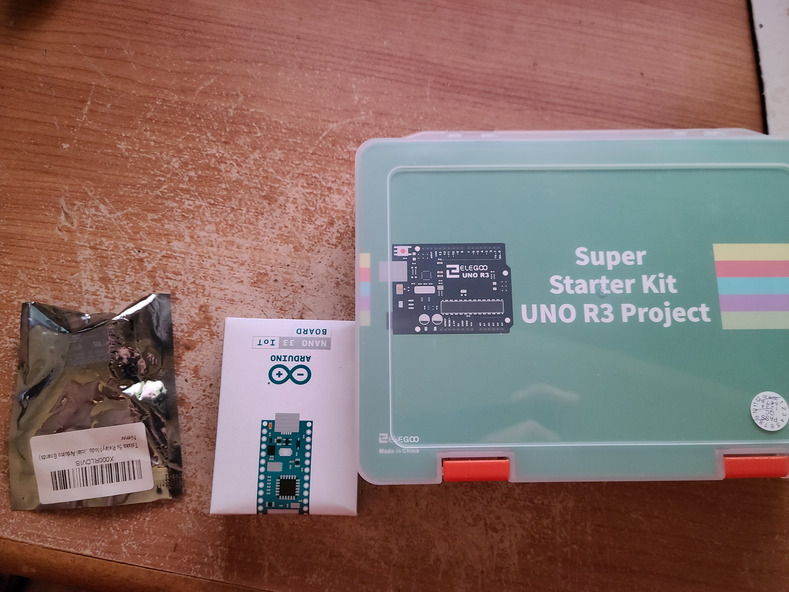
Received Arduino Parts
Originally bought the Starter Kit shown on the right.
Bought an Arduino Nano as the included Uno was too big for the project and a circuit relay as the kit did not come with one.

Slide 3
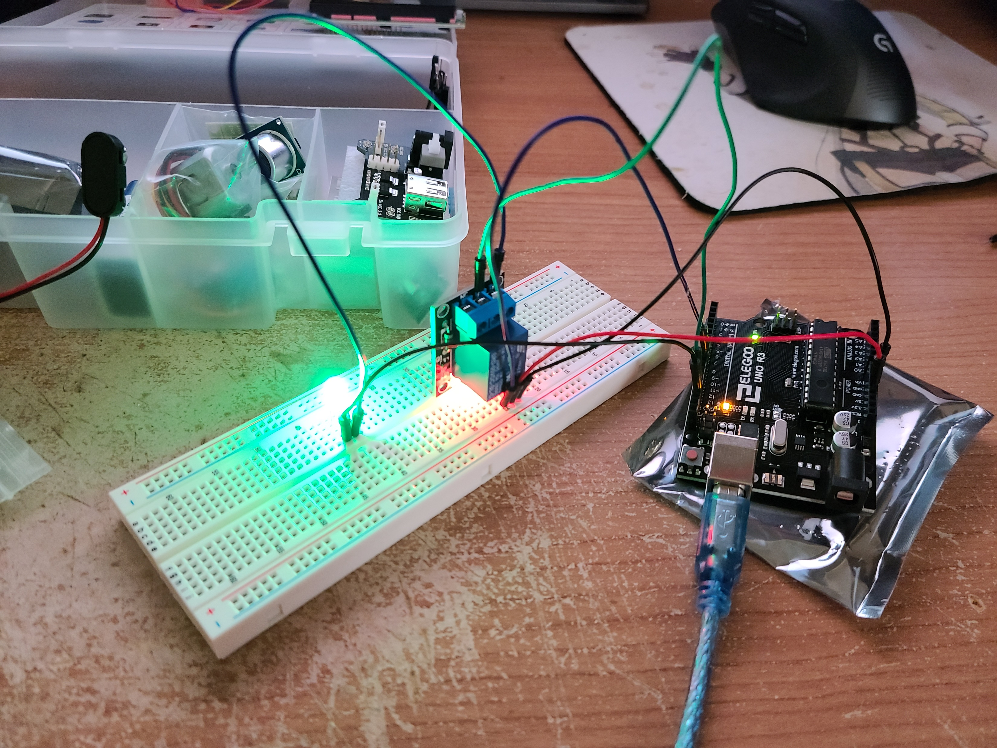
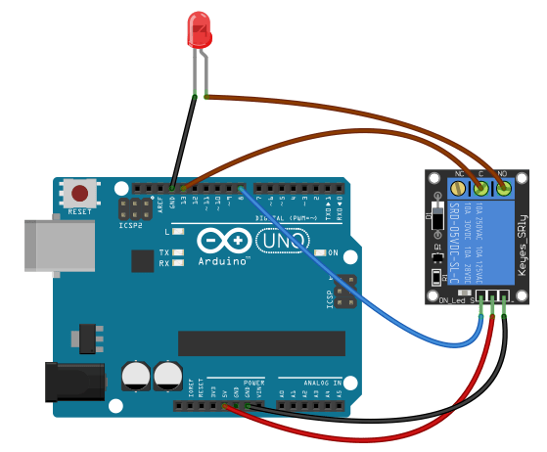
Testing Circuit Relay
Testing to know how this relay works. The image shown is the second attempt. The first blew the LED.
As this will be used to cut on/off a wall outlet power. Because of the amount of electricity from a wall outlet, I am testing it with an LED and the Uno.
Power is ran from pin 13 to the relay, then to the LED and back to ground. The Uno is then hooked to control the relay.
The test shown I wrote turns the relay on and off every 1 second to flash the LED.

